Slide 1
LECTURE 3

Slide 2





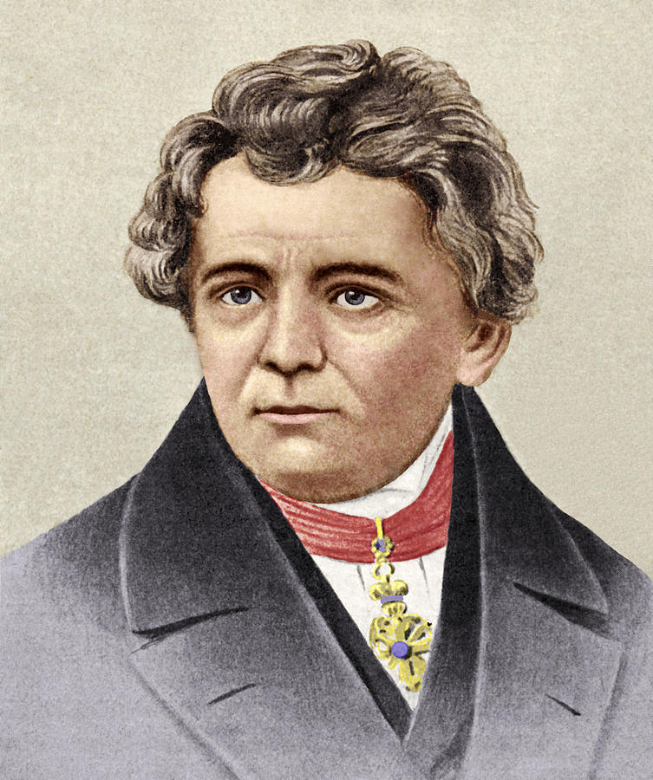




OHM’S LAW
Ohms law states that, the current (I) flowing through a metallic conductor is directly proportional to the potential difference (V), across its ends provided its temperature remains the same.
OHM’S law gives relation between two electric quantities
I
I
I
–
–
+
–
+
+
Length,
Area of cross section,
Temperature and
Material remain constant.
V
V
V
V = I × R
Hence, V = IR
V α I
GEORGE SIMON OHM
This is known as Ohm’s law.
V
= Constant
I
= R (Resistance)

Slide 3
The S.I. unit of RESISTANCE (R) is ohm (Ω)
RESISTANCE
V
1
volt
1
R =
ohm
=
I
1
ampere
Current is more
Current is less
If potential difference across two ends of a conductor is one volt and the current through it is 1 ampere, then the resistance of conductor is 1 ohm
The property of the conductor due to which it opposes flow of current is called RESISTANCE
When atoms are less,
Resistance is less
When atoms are more,
Resistance is more
+
-

Slide 4





FACTORS AFFECTING RESISTANCE
Length
R α L
Area of cross-section
$$\frac{\text{1}}{\text{A}}$$
R α
Material
$$\frac{\text{L}}{\text{A}}$$
∴ R α
Temperature
Temperature
$$\frac{\text{L}}{\text{A}}$$
∴
ρ
R =
ρ-rho
If the door is wider,
more people can enter
resistance is less.
If wire is thicker,
more electrons can flow
as resistance is less
1
Hence Rα
$$\frac{\text{L}}{\text{A}}$$
Unit of RESISTIVITY (ρ) :
R =
ρ
∴
A
Ω
m²
R
A
R
A
ρ =
∴
ρ =
∴
m
L
L
S. I unit of resistivity is ohm – metre (Ω – m).

Slide 5


Practical understanding of resistivity
1. Resistivity is a specific property of a material.
20
10
30
A
B
0
40
2. Different materials have different resistivity
A
copper wire
Aluminium wire
Glass rod
Rubber
+
–
Electric Circuit

Slide 6
Q.1.
On what factors does the resistance of a conductor depend?
Ans. :
The resistance of a conductor depends on its
Length
Area of cross – section (thickness)
Material
Temperature

Slide 7
Q.2.
How does the resistance of a wire change when:
(a) Its length is tripled?
(b) Its diameter is tripled?
(c) Its material is changed to one whose resistivity is three time?
Ans. :
ρ
l
R =
A
(a)
R α l
∴ If l is tripled, resistance is also tripled.
(b)
R α
1
or
A
(c)
R α ρ
1
πd²
R α
πr²
∴ A =
=
d²
4
∴ If resistivity is tripled,
resistance is also tripled
∴ If the diameter is tripled Resistance becomes 1/9 times

Slide 8
Q.3.
Will current flow more easily through a thick wire or a thin wire of the same material, when connected to the same source? Why?
Ans. :
(i) When connected to a same source, current will flow more easily through the thick wire than the thin wire.
1
(ii) Resistance R α
A

Slide 9
Thank You

